Slide 1

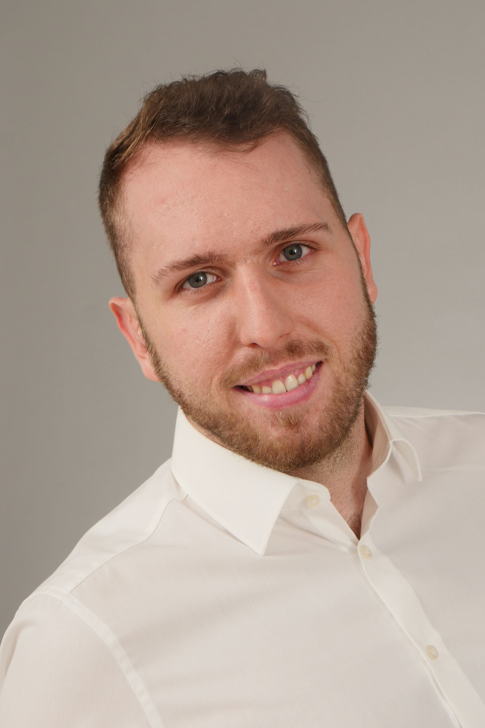
David Wolz
Bachelor of Science
Applied Science - Digitale Medien
Karlstein am Main
25 Years old

Slide 2
Who I am
Career
Current
2-year training in Graphic Design
1 year of practical experience as a Software Engineer
Created and hosted websites
Currently working as IT-Manager
App Support
- Apptests
-Analysis
Notes:
2-year training in Graphic Design
1 year of practical experience as a Software Engineer during university studies
Created and hosted websites during university studies
-------
To summarize I worked on a lot off different fields surrounding App or Webdesign.
I have acquired these accomplishments with my way of doing things

Slide 3
INVENTIVE
1
I approach problems in creative ways
INDEPENDENCE
I strengthen teams from within by taking responsibility and working reliably.
I stay focused and productive, which allows others to trust and build on my work
2
Perseverance
I don´t give up easily. I stay committed to my goals and keep trying
3
Notes:
INDEPENDENCE
I strengthen teams from within by taking responsibility and working reliably.
I stay focused and productive, which allows others to trust and build on my work

Slide 4
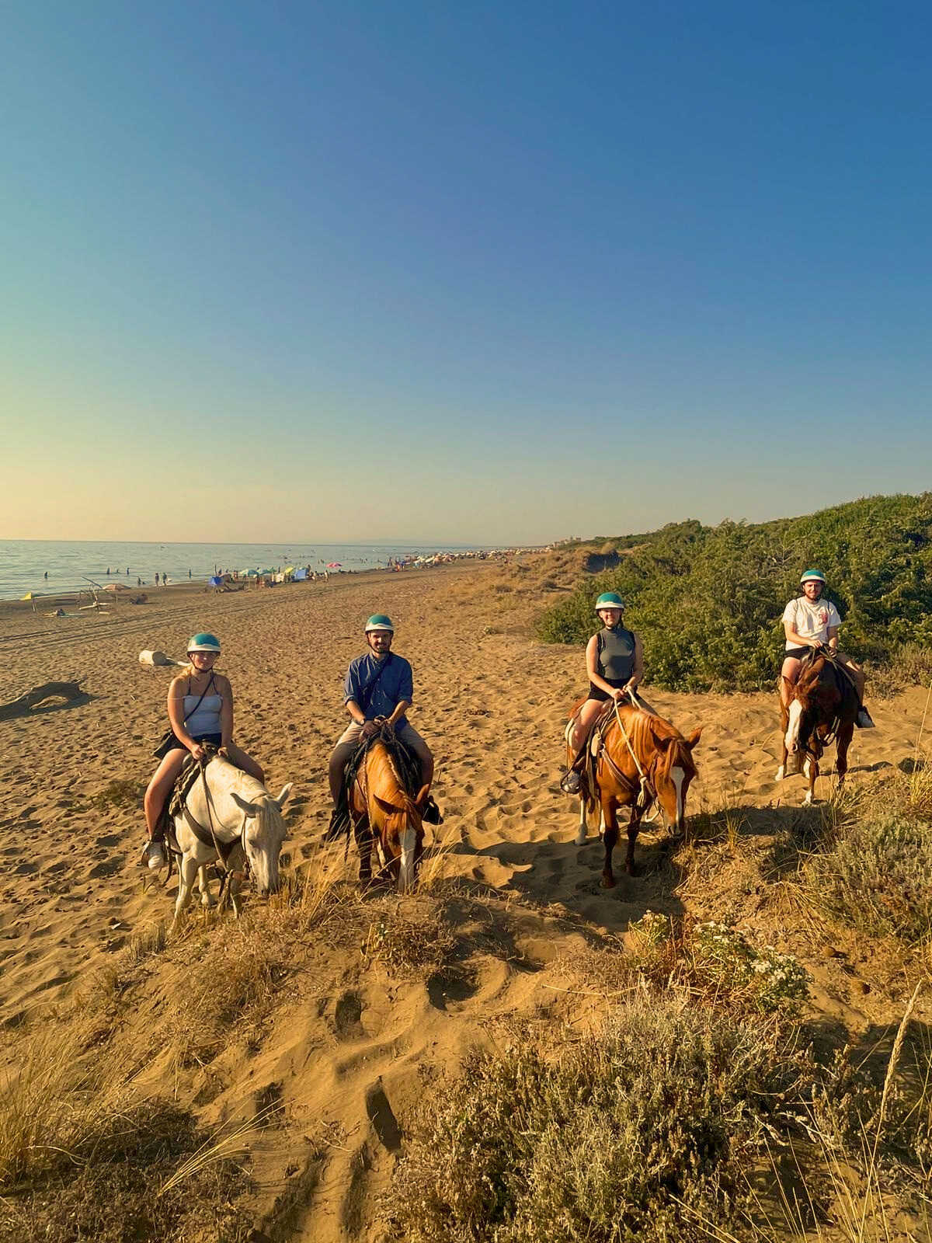
When was the last time that you did something for the first time
Horsebackriding in Italy
Unique Experience
Notes:
Last Year was filled with a lot of firsts
- finished my Bachelor
- moved together with my girlfriend
- started working
- first Apptest at new job
and a lot of other more
insignifecent stuff. But the first thing that came to mind when i read the sentece was to go horsebackriding with some friends
- It was a very unique Experience that we wanted to try.

Slide 5
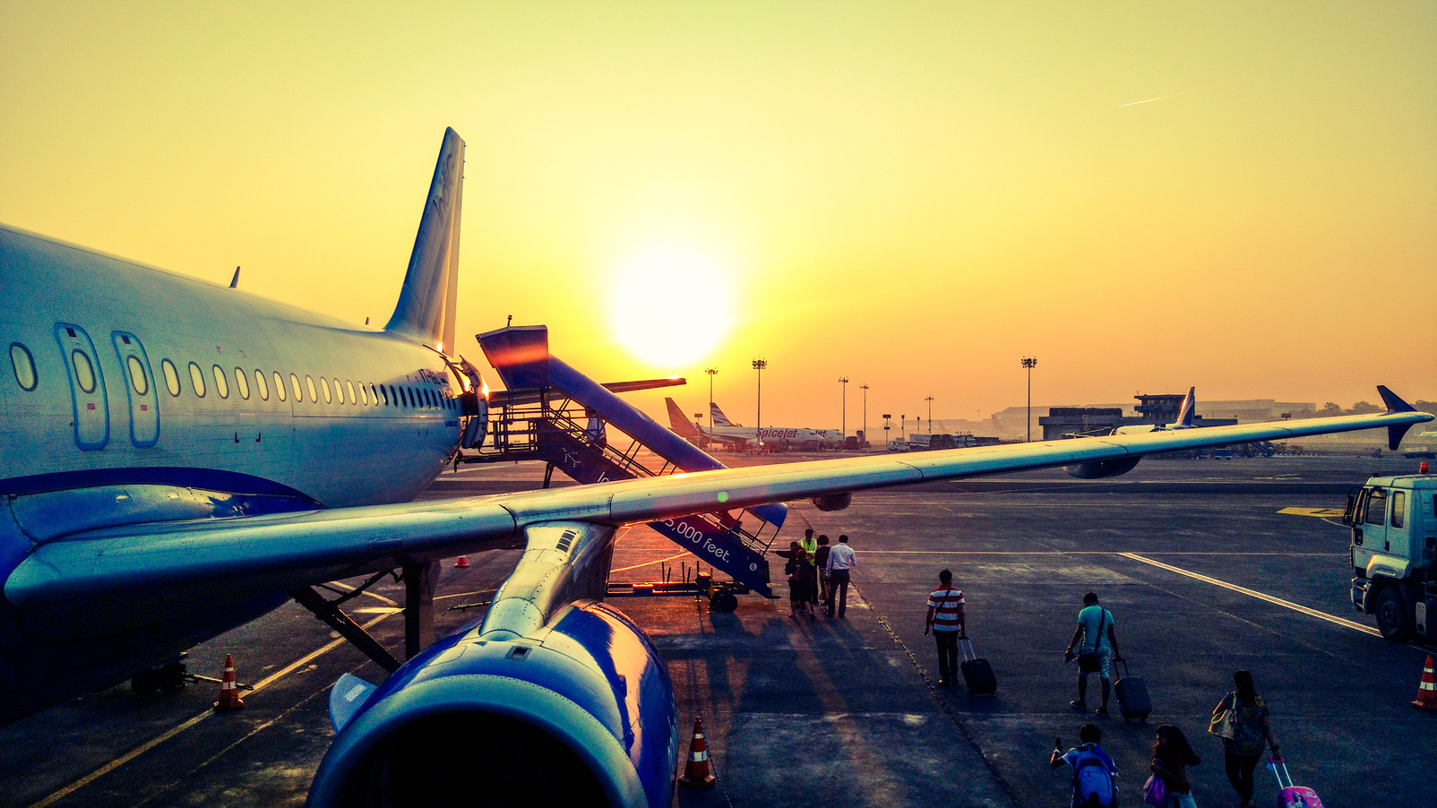

What professional or personal goals do you have
Personal
Professional
big vacation trip with friends
become the backbone of a team
Notes:
Personal:
- big Vacation Trip with friends
- around 8 people
- we have to see but if possible outside of Europe
Professional:
like I said before. One of my Strenghts is that i am reliable which allows others to trust my work.
I would like to become something like that for a team

Slide 6
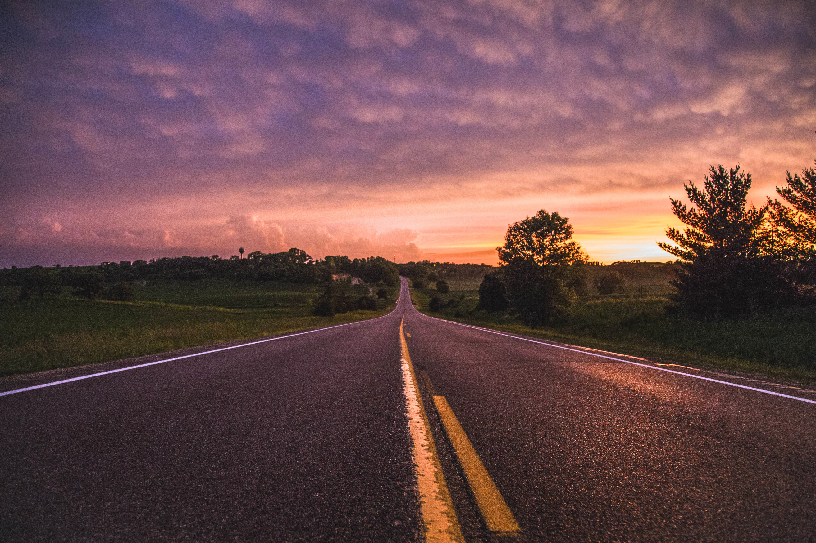
What conditions should be met for you to consider the program successful
Notes:
---
I really like this Program and feel like what this Firm tries to do is very admirable. So simply put is my Goal to show what i am capaple off to get hired after the Trainee-programm

